Slide 1
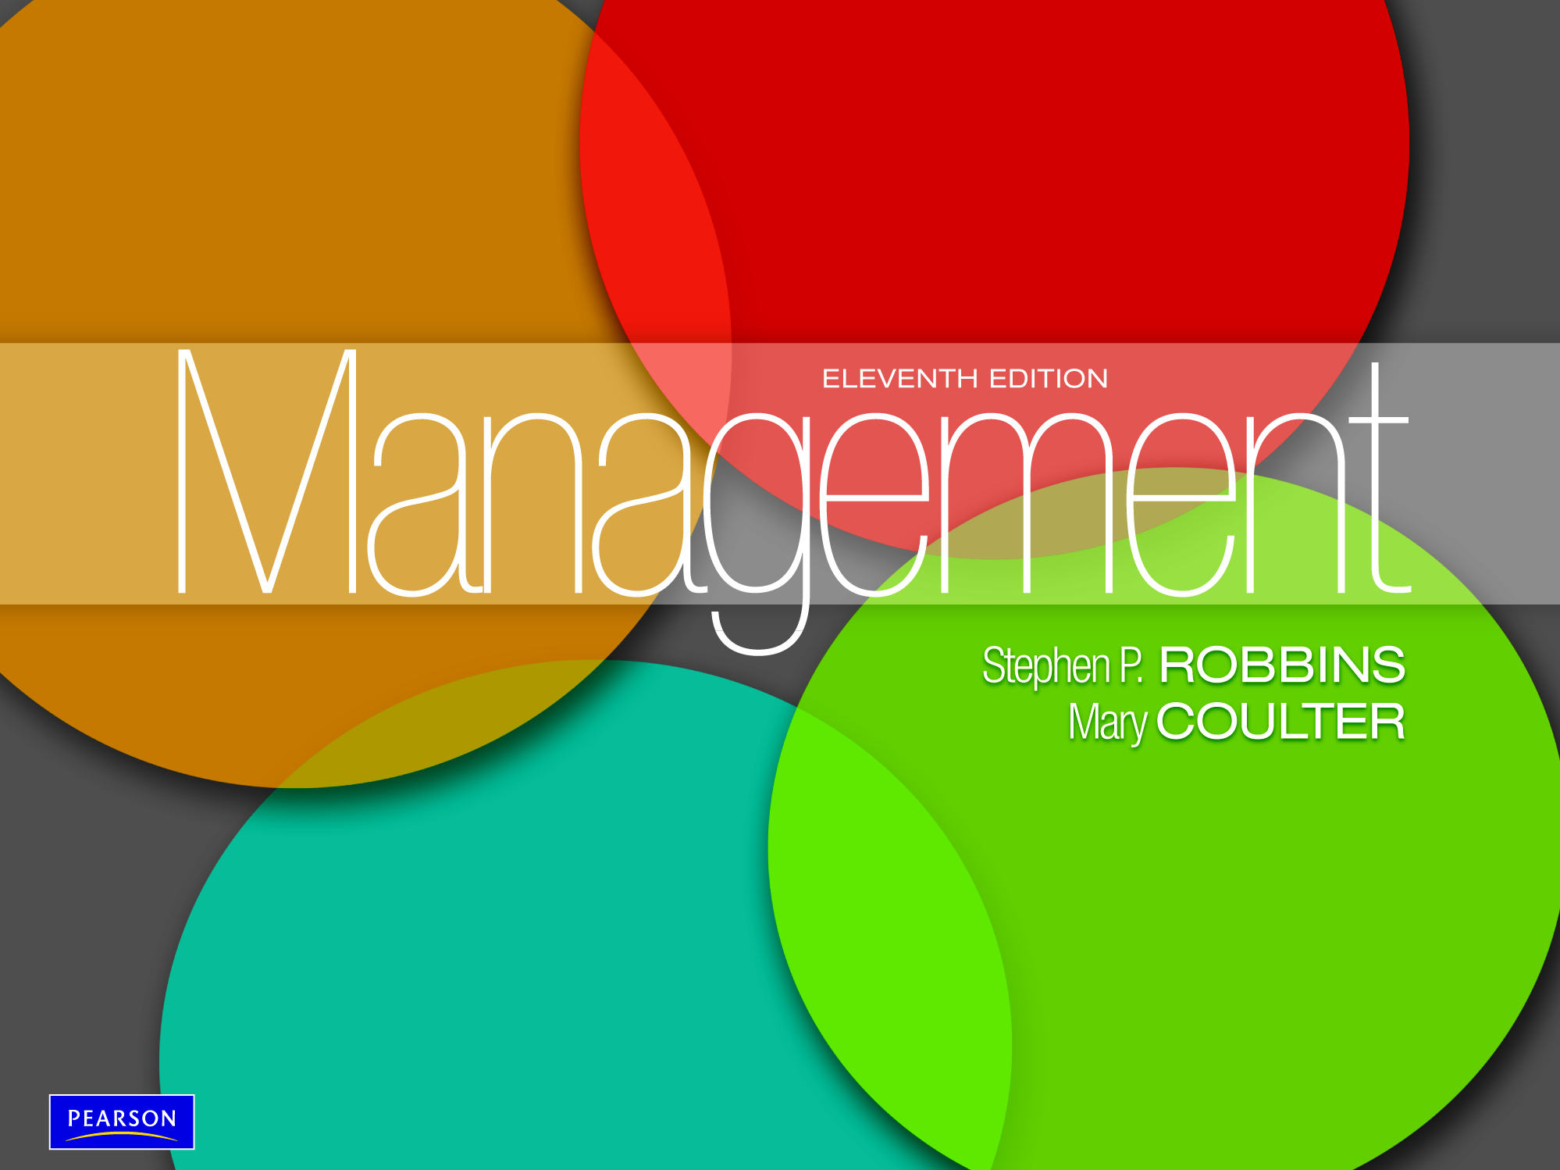

Slide 2

Describe the eight steps in the decision-
making process
Explain the four ways managers make decisions
Classify decisions and decision-making
conditions
Classify decisions and decision-making
conditions
Identify effective decision-making techniques

Slide 3
Decision Making
Decision - making a choice from two or more alternatives.
Problem - an obstacle that makes it difficult to achieve a desired goal or purpose.

Slide 4
The Decision Making Process
Identifying a problem and decision criteria and allocating weights to the criteria
Developing, analyzing, and selecting an alternative that can resolve the problem
Implementing the selected alternative
Evaluating the decision’s effectiveness

Slide 5
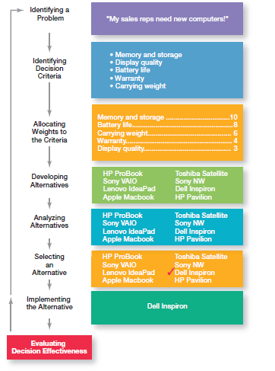
Exhibit 7-1: Decision-Making Process

Slide 6
Step 1: Identifying a Problem
Characteristics of Problems
A problem becomes a problem when a manager becomes aware of it.
There is pressure to solve the problem.
The manager must have the authority, information, or resources needed to solve the problem.

Slide 7
Step 2: Identifying Decision Criteria
Decision criteria are factors that are important (relevant) to resolving the problem, such as:
Costs that will be incurred (investments required)
Risks likely to be encountered (chance of failure)
Outcomes that are desired (growth of the firm)

Slide 8
Exhibit 7-2: Important Decision Criteria

Slide 9
Step 3: Allocating Weights to the Criteria
Decision criteria are not of equal importance:
Assigning a weight to each item places the items in the correct priority order of their importance in the decision-making process.

Slide 10
Step 4: Developing Alternatives
Identifying viable alternatives
Alternatives are listed (without evaluation) that can resolve the problem.

Slide 11
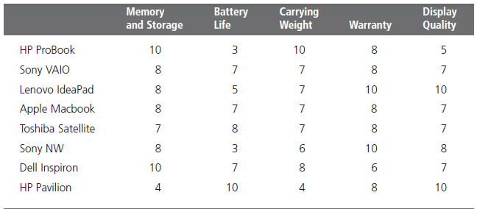
Exhibit 7-3: Possible Alternatives

Slide 12
Step 5: Analyzing Alternatives
Appraising each alternative’s strengths and weaknesses
An alternative’s appraisal is based on its ability to resolve the issues related to the criteria and criteria weight.

Slide 13
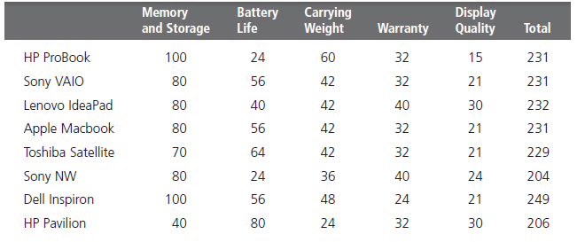
Exhibit 7-4: Evaluation of Alternatives

Slide 14
Step 6: Selecting an Alternative
Choosing the best alternative
The alternative with the highest total weight is chosen.

Slide 15
Step 7: Implementing the Alternative
Putting the chosen alternative into action
- Conveying the decision to and gaining commitment from those who will carry out the alternative

Slide 16
Step 8: Evaluating Decision Effectiveness
The soundness of the decision is judged by its outcomes.
How effectively was the problem resolved by outcomes resulting from the chosen alternatives?
If the problem was not resolved, what went wrong?

Slide 17
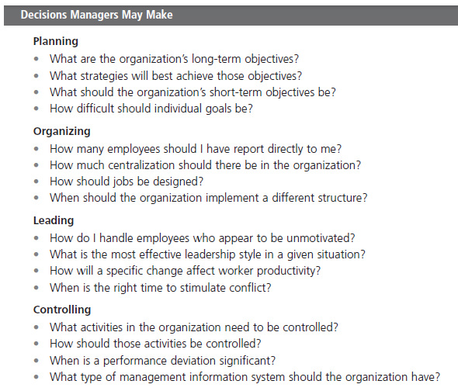
Exhibit 7-5: Decisions Managers May Make

Slide 18
Rational Decision-Making
Rational Decision-Making - describes choices that are logical and consistent while maximizing value.
Bounded Rationality - decision making that’s rational, but limited (bounded) by an individual’s ability to process information.
Satisfice - accepting solutions that are “good enough.”

Slide 19

Intuitive Decision-Making
Intuitive decision- making
Making decisions on the basis of experience, feelings, and accumulated judgment.

Slide 20
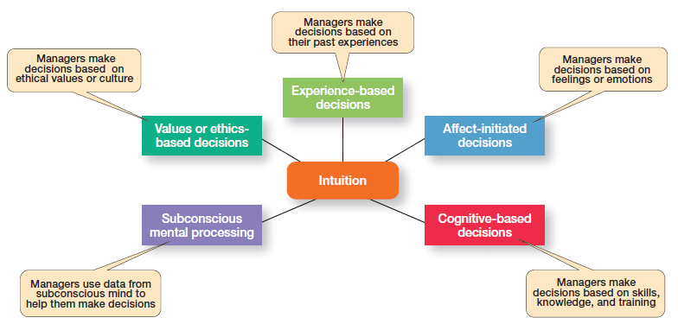
Exhibit 7-6: What Is Intuition?

Slide 21
Programmed vs. Non- Programmed Decisions
Programmed Decision - a repetitive decision that can be handled by a routine approach.
Non-programmed Decisions - unique and nonrecurring decisions that require a custom-made solution.

Slide 22
Types of Programmed Decisions
Procedure - a series of interrelated steps that a manager can use to apply a policy in response to a structured problem.
Rule - an explicit statement that limits what a manager or employee can or cannot do.
Policy - a general guideline for making a decision about a structured problem.

Slide 23
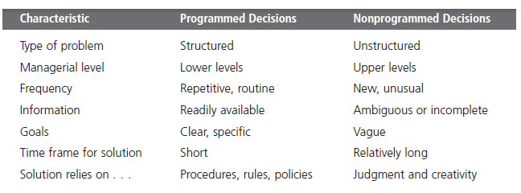
Exhibit 7-7: Programmed Versus Non-programmed Decisions

Slide 24
Types of Problems
Structured Problems - straightforward, familiar, and easily defined problems.
Unstructured Problems - problems that are new or unusual and for which information is ambiguous or incomplete.

Slide 25
Decision-Making Situations
Certainty
a situation in which a manager can make an accurate decision because the outcome of every alternative choice is known.
Risk
a situation in which the manager is able to estimate the likelihood (probability) of outcomes that result from the choice of particular alternatives.

Slide 26
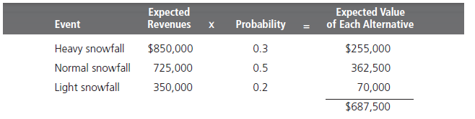
Exhibit 7-8: Expected Value

Slide 27
Decisions Under Uncertainty
Limited information prevents estimation of outcome probabilities for alternatives .
Limited information forces managers to rely on intuition, hunches, and “gut feelings.”
Maximax: the optimistic manager’s choice to maximize the maximum payoff.
Maximin: the pessimistic manager’s choice to maximize the minimum payoff.
Minimax: the manager’s choice to minimize maximum regret.

Slide 28
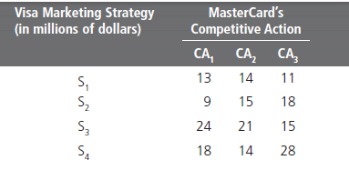
Exhibit 7-9: Payoff Matrix

Slide 29
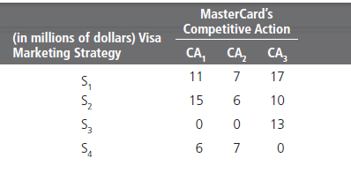
Exhibit 7-10: Regret Matrix

Slide 30
Decision-Making Styles
Linear Thinking Style - a person’s tendency to use external data/facts; the habit of processing information through rational, logical thinking.
Nonlinear Thinking Style - a person’s preference for internal sources of information; a method of processing this information with internal insights, feelings, and hunches.

Slide 31
Decision-Making Biases and Errors
Heuristics - using “rules of thumb” to simplify decision making.
Overconfidence Bias - holding unrealistically positive views of oneself and one’s performance.
Immediate Gratification Bias - choosing alternatives that offer immediate rewards and avoid immediate costs.

Slide 32
Decision-Making Biases and Errors (cont.)
Anchoring Effect - fixating on initial information and ignoring subsequent information.
Selective Perception Bias - selecting, organizing and interpreting events based on the decision maker’s biased perceptions.
Confirmation Bias - seeking out information that reaffirms past choices while discounting contradictory information.

Slide 33
Decision-Making Biases and Errors (cont.)
Framing Bias - selecting and highlighting certain aspects of a situation while ignoring other aspects.
Availability Bias - losing decision-making objectivity by focusing on the most recent events.
Representation Bias - drawing analogies and seeing identical situations when none exist.
Randomness Bias - creating unfounded meaning out of random events.

Slide 34
Decision-Making Biases and Errors (cont.)
Sunk Costs Errors - forgetting that current actions cannot influence past events and relate only to future consequences.
Self-Serving Bias - taking quick credit for successes and blaming outside factors for failures.
Hindsight Bias - mistakenly believing that an event could have been predicted once the actual outcome is known (after-the-fact).

Slide 35
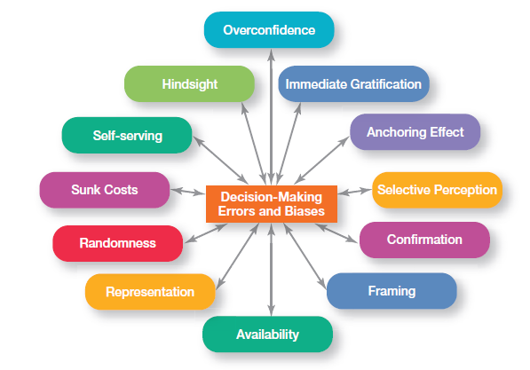
Exhibit 7-10: Common Decision-Making Biases

Slide 36
Decision Making for Today’s World
Guidelines for making effective decisions:
Understand cultural differences
Know when it’s time to call it quits
Use an effective decision making process
Habits of highly reliable organizations (HROs)
Are not tricked by their success
Defer to the experts on the front line
Let unexpected circumstances provide the solution
Embrace complexity
Anticipate, but also anticipate their limits

Slide 37
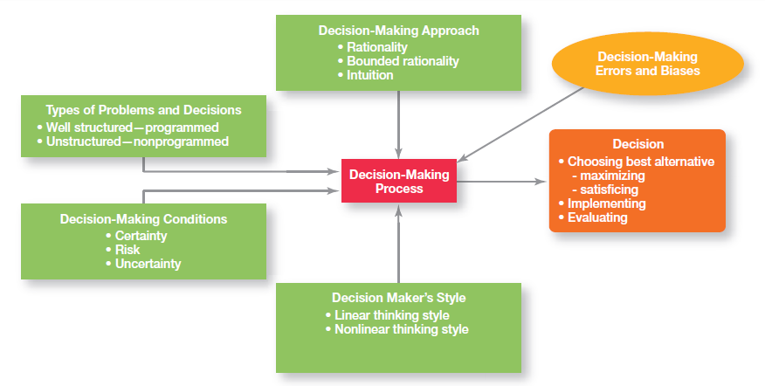
Exhibit 7-12: Overview of Managerial Decision Making

Slide 38
Terms to Know
Decision criteria
Rational decision making
Bounded rationality
Satisfice
Escalation of commitment
Intuitive decision making
Evidence-based management (EBMgt)
Structured problems
Programmed decision
Procedure
Rule
Policy
Unstructured problems
Nonprogrammed decisions
Risk
Linear thinking style
Nonlinear thinking style
Heuristics
Notes:
38

